Slide 1



Transportation Reports
View in Power BI
Last data refresh:
2/19/2024 8:49:36 AM UTC
Downloaded at:
2/19/2024 9:52:21 AM UTC

Slide 2
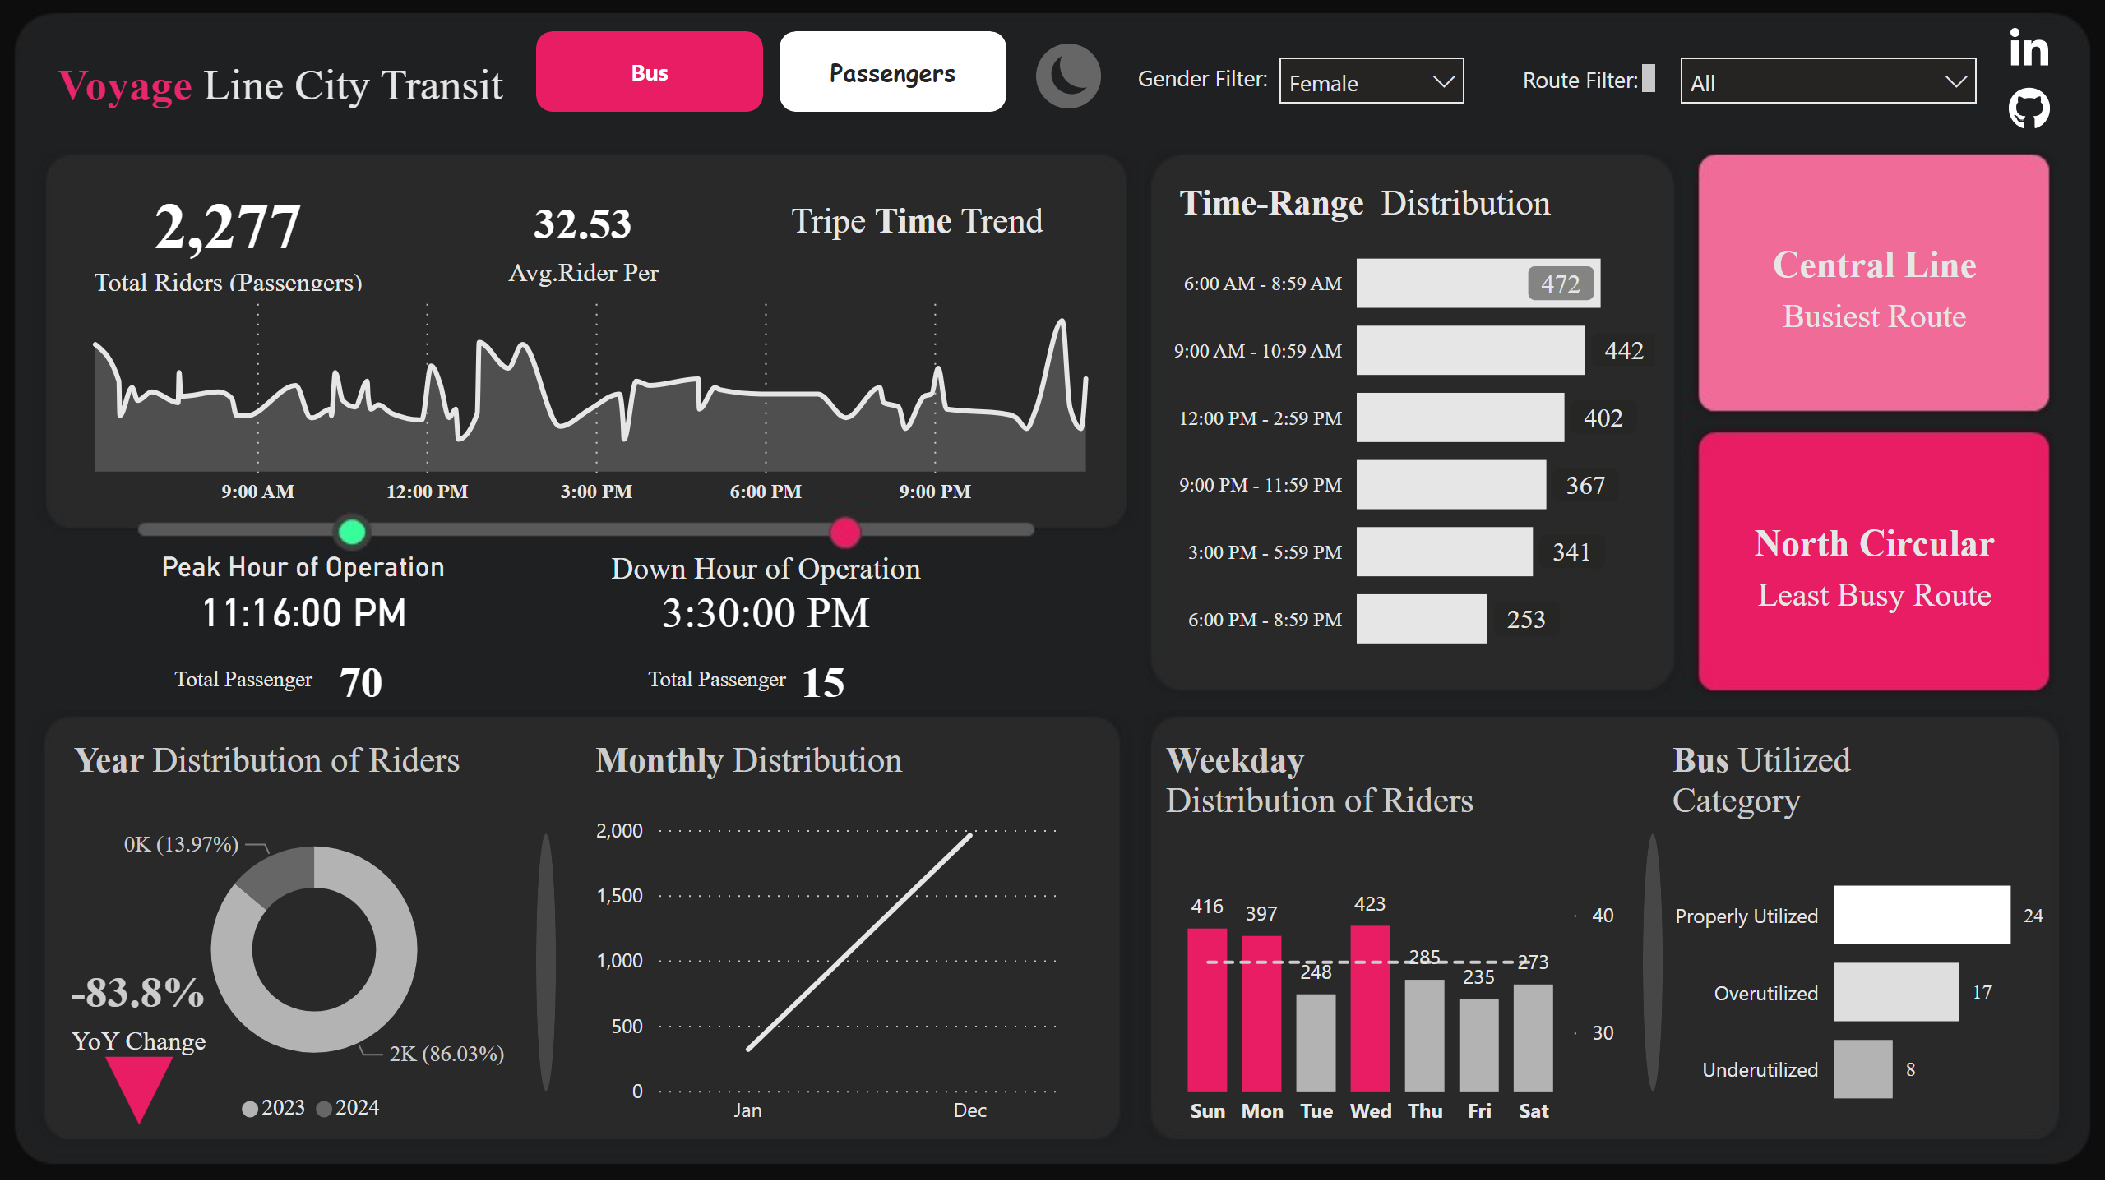
Bus
Notes:
card
No alt text provided
card
No alt text provided
clusteredBarChart
No alt text provided
areaChart
No alt text provided
Peak Hour of Operation
No alt text provided
Down Hour of Operation
No alt text provided
card
No alt text provided
card
No alt text provided
clusteredBarChart
No alt text provided
lineStackedColumnComboChart
No alt text provided
lineChart
No alt text provided
donutChart
No alt text provided
card
No alt text provided
card
No alt text provided
textbox
No alt text provided
textbox
No alt text provided
textbox
No alt text provided
card
No alt text provided
card
No alt text provided
textbox
No alt text provided
Ginder
No alt text provided
textbox
No alt text provided
slicer
No alt text provided
textbox
No alt text provided
textbox
No alt text provided
textbox
No alt text provided
textbox
No alt text provided
textbox
No alt text provided
textbox
No alt text provided
image
No alt text provided
image
No alt text provided
shape
No alt text provided
shape
No alt text provided
image
No alt text provided
pageNavigator
No alt text provided

Slide 3
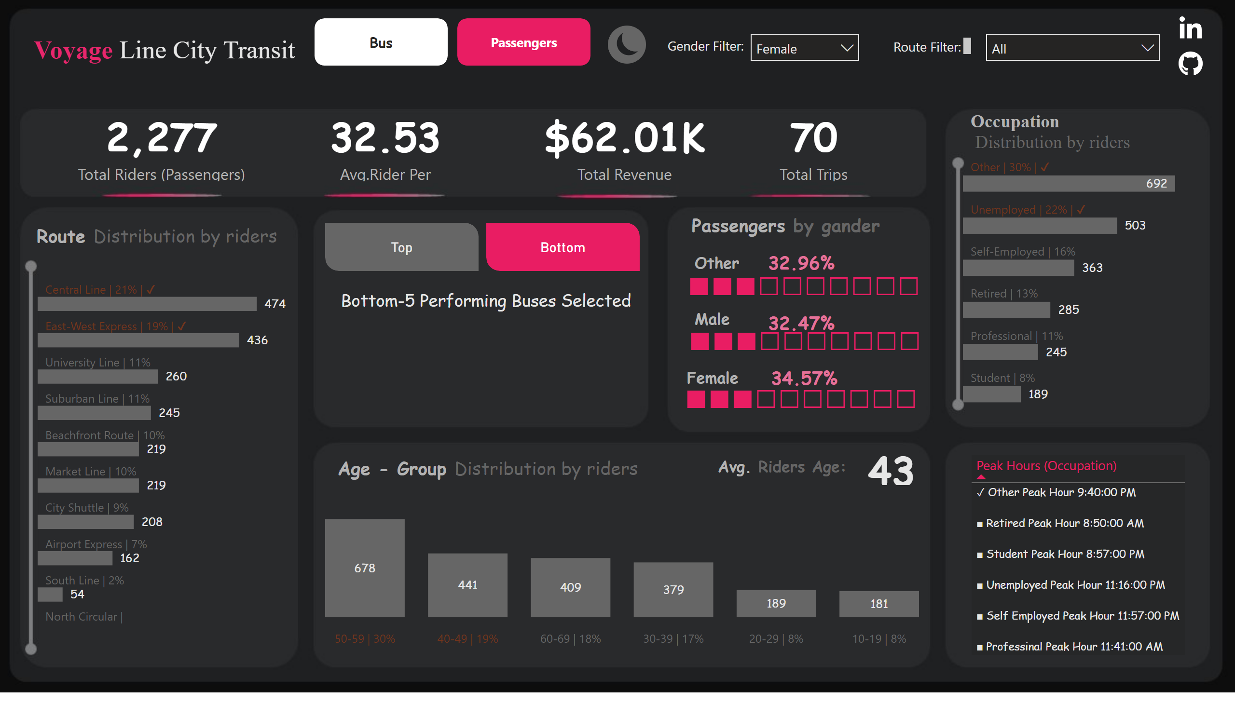
Passengers
Notes:
clusteredColumnChart
No alt text provided
advancedSlicerVisual
No alt text provided
card
No alt text provided
tableEx
No alt text provided
card
No alt text provided
card
No alt text provided
card
No alt text provided
card
No alt text provided
columnChart
No alt text provided
clusteredBarChart
No alt text provided
clusteredBarChart
No alt text provided
card
No alt text provided
card
No alt text provided
card
No alt text provided
textbox
No alt text provided
image
No alt text provided
textbox
No alt text provided
textbox
No alt text provided
Ginder
No alt text provided
slicer
No alt text provided
image
No alt text provided
image
No alt text provided
textbox
No alt text provided
textbox
No alt text provided
textbox
No alt text provided
textbox
No alt text provided
textbox
No alt text provided
textbox
No alt text provided
textbox
No alt text provided
card
No alt text provided
card
No alt text provided
pageNavigator
No alt text provided
card
No alt text provided
textbox
No alt text provided
card
No alt text provided

Slide 4
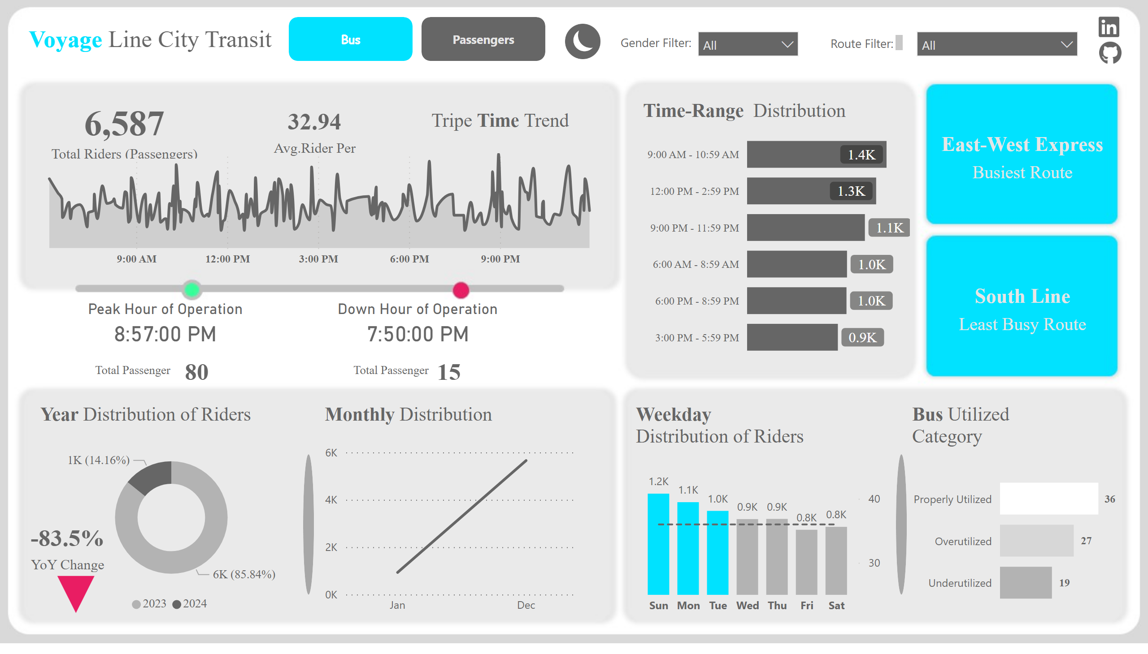
Bus
Notes:
card
No alt text provided
card
No alt text provided
clusteredBarChart
No alt text provided
areaChart
No alt text provided
Peak Hour of Operation
No alt text provided
Down Hour of Operation
No alt text provided
card
No alt text provided
card
No alt text provided
clusteredBarChart
No alt text provided
lineStackedColumnComboChart
No alt text provided
lineChart
No alt text provided
donutChart
No alt text provided
card
No alt text provided
card
No alt text provided
textbox
No alt text provided
textbox
No alt text provided
textbox
No alt text provided
card
No alt text provided
card
No alt text provided
textbox
No alt text provided
Ginder
No alt text provided
textbox
No alt text provided
slicer
No alt text provided
textbox
No alt text provided
textbox
No alt text provided
textbox
No alt text provided
textbox
No alt text provided
textbox
No alt text provided
textbox
No alt text provided
image
No alt text provided
image
No alt text provided
shape
No alt text provided
shape
No alt text provided
image
No alt text provided
pageNavigator
No alt text provided

Slide 5
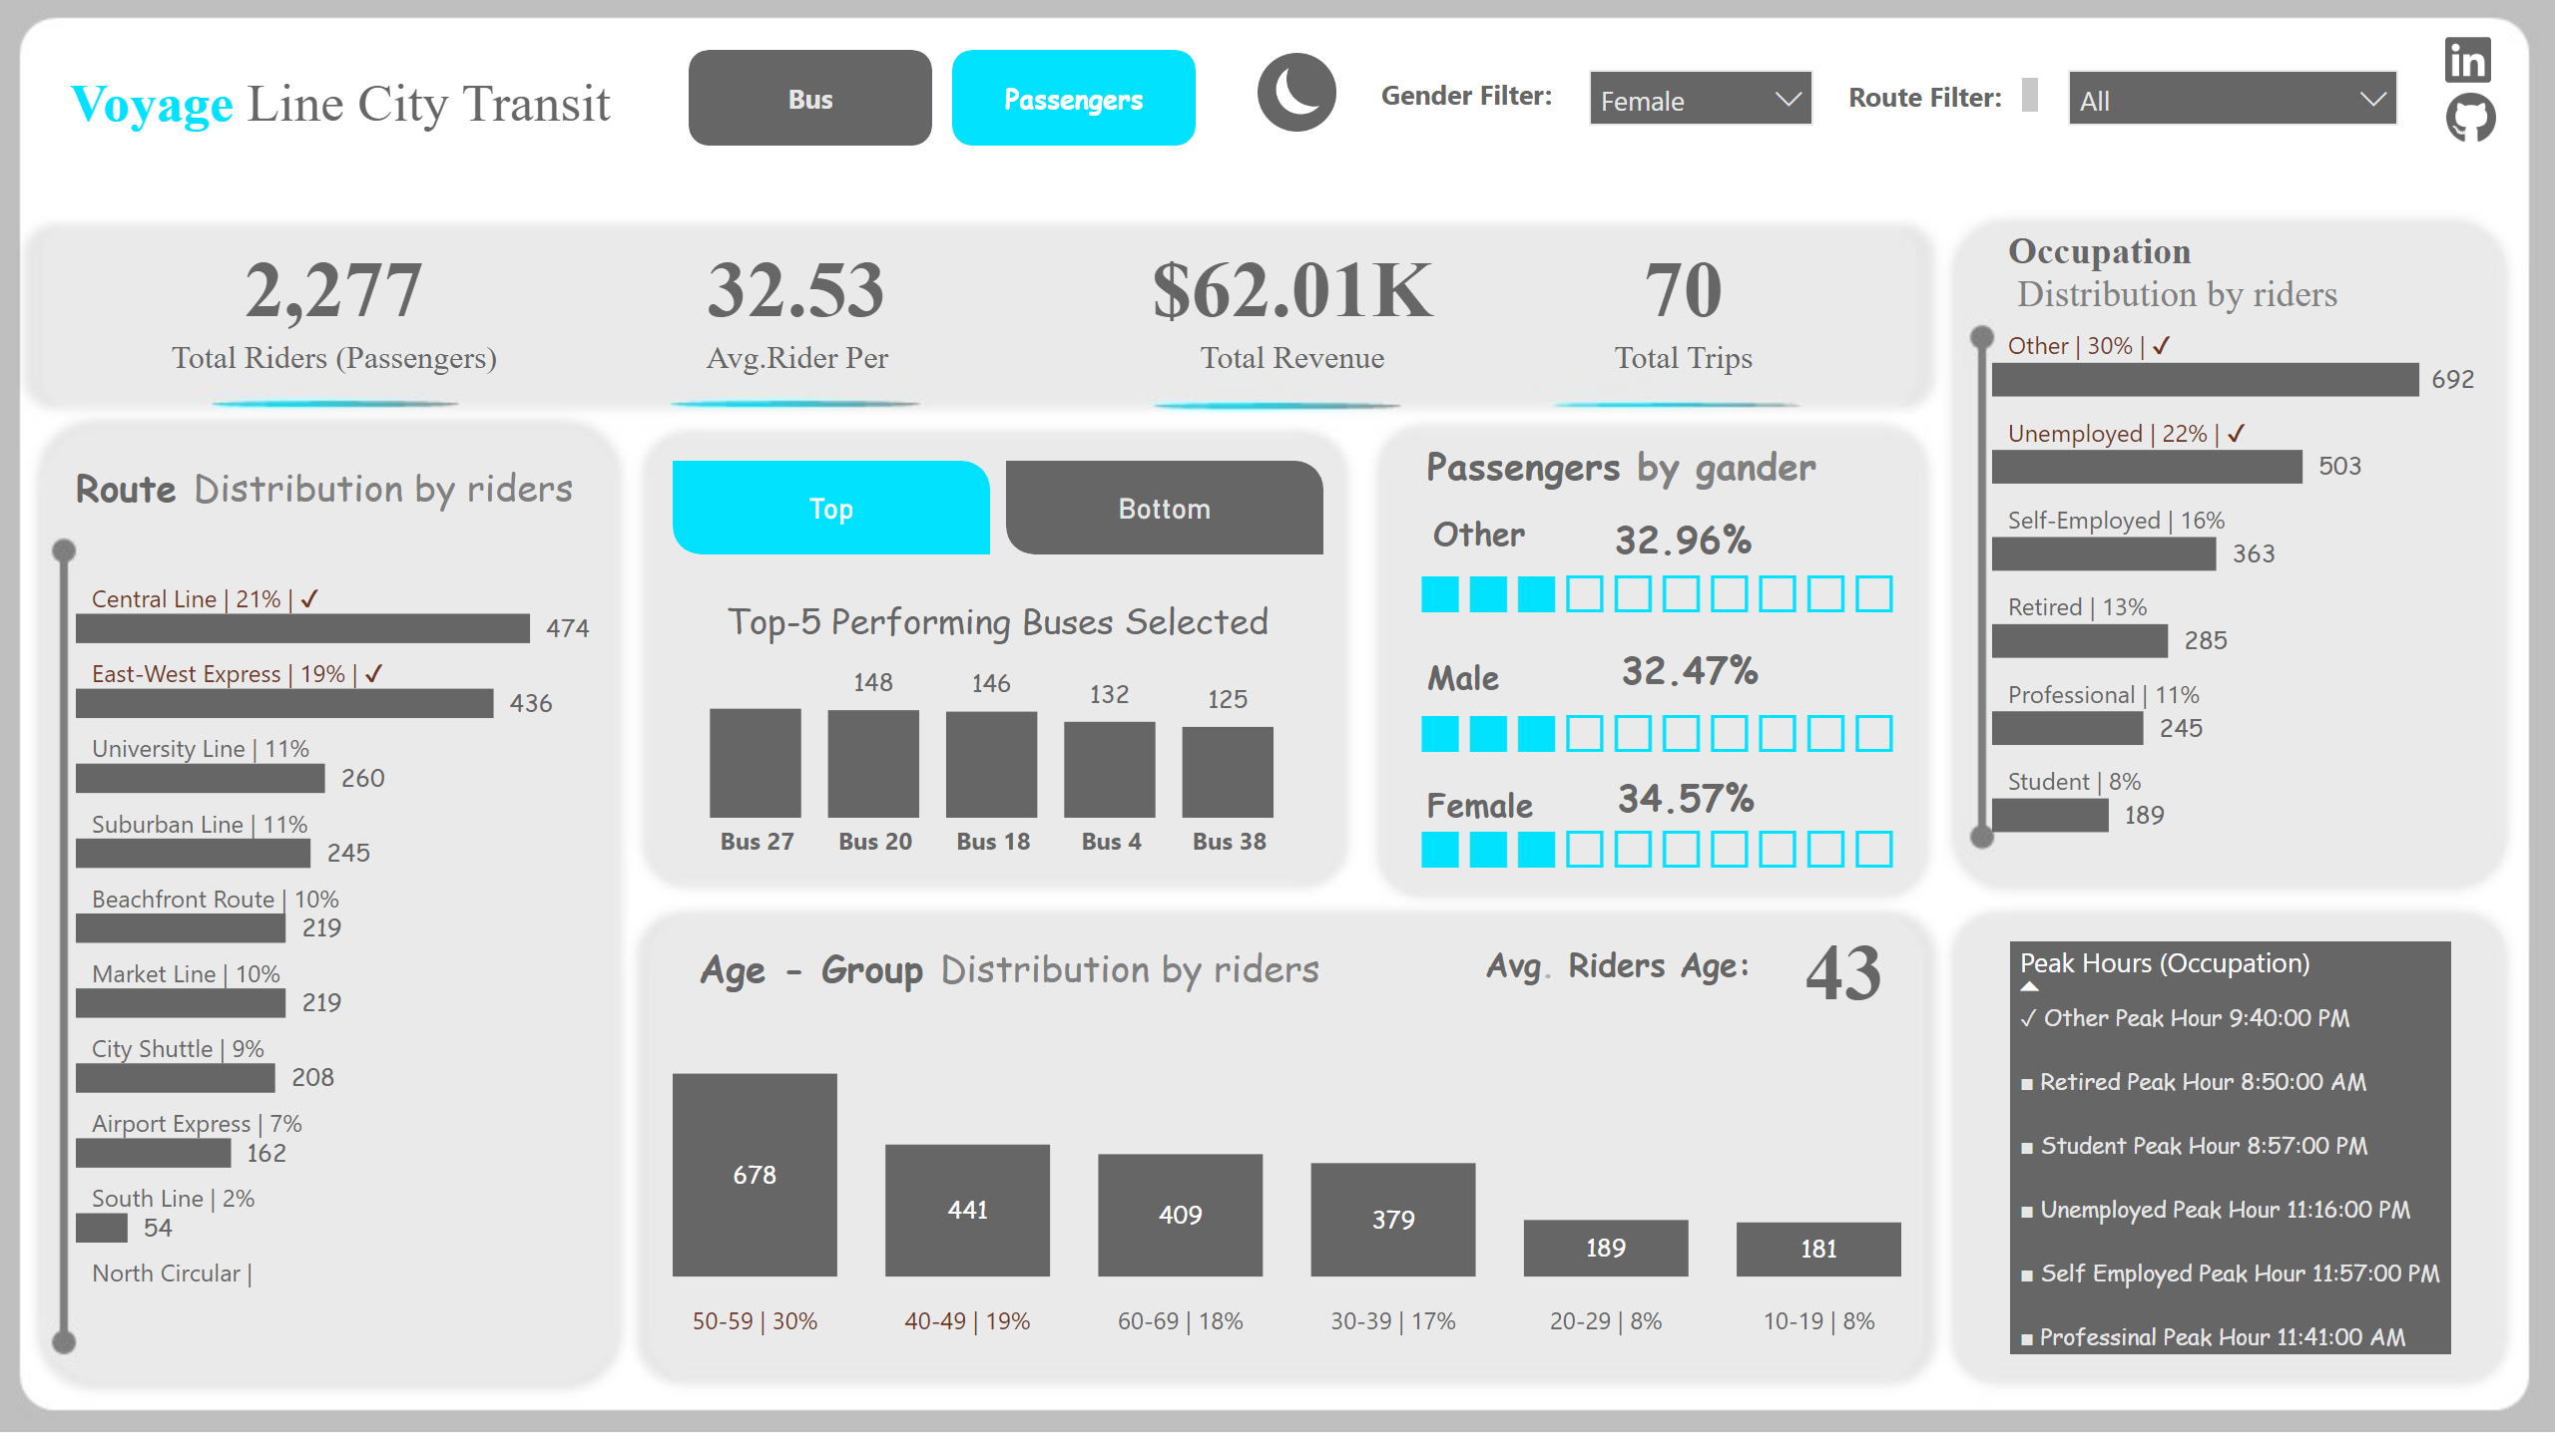
Passengers
Notes:
clusteredColumnChart
No alt text provided
advancedSlicerVisual
No alt text provided
card
No alt text provided
tableEx
No alt text provided
card
No alt text provided
card
No alt text provided
card
No alt text provided
card
No alt text provided
columnChart
No alt text provided
clusteredBarChart
No alt text provided
clusteredBarChart
No alt text provided
card
No alt text provided
card
No alt text provided
card
No alt text provided
textbox
No alt text provided
image
No alt text provided
textbox
No alt text provided
textbox
No alt text provided
Ginder
No alt text provided
slicer
No alt text provided
textbox
No alt text provided
textbox
No alt text provided
textbox
No alt text provided
textbox
No alt text provided
textbox
No alt text provided
textbox
No alt text provided
textbox
No alt text provided
card
No alt text provided
card
No alt text provided
pageNavigator
No alt text provided
image
No alt text provided
card
No alt text provided
textbox
No alt text provided
card
No alt text provided
image
No alt text provided

